Slide 1

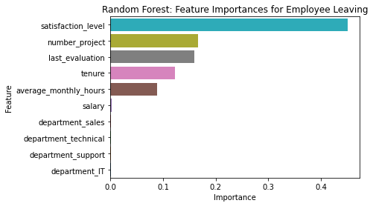
Salifort Motors
Employee Retention Project
Salifort Motors seeks to improve employee retention and answer the following question:
What’s likely to make the employee leave the company?
Since the variable we are seeking to predict is categorical, we build a tree-based machine learning model.
The random forest model slightly outperforms the decision tree model.
Barplot above shows the most relevant variables in decision tree model: `satisfaction_level`, `last_evaluation`,` number_project`, `tenure`, and `average_monthly_hours`
This model helps predict whether an employee will leave and identify which factors are most influential. These insights can help HR make decisions to improve employee retention.
Barplot above shows the most relevant variables in random forest model: `satisfaction_level`, `number_project`, `last_evaluation`, `tenure`, and `average_monthly_hours`.
Don't wait for annual reviews. Implement lightweight, quarterly "pulse surveys" to get a real-time, predictive measure of company-wide satisfaction.
Create workload alerts. Managers should be notified when an employee is assigned 5+ projects or logs over 280 hours, as these are top burnout indicators.
The "sweet spot" for retention is 3-4 projects.
Proactively engage with employees in the 4-6 year "burnout window." This is the critical time to discuss career growth, promotions, or new assignments to keep them engaged.

